Slide 1


Dr B R Ambedkar National Institute of Technology Jalandhar
2-month
Internship at
PINPENCIL LLP

Slide 2
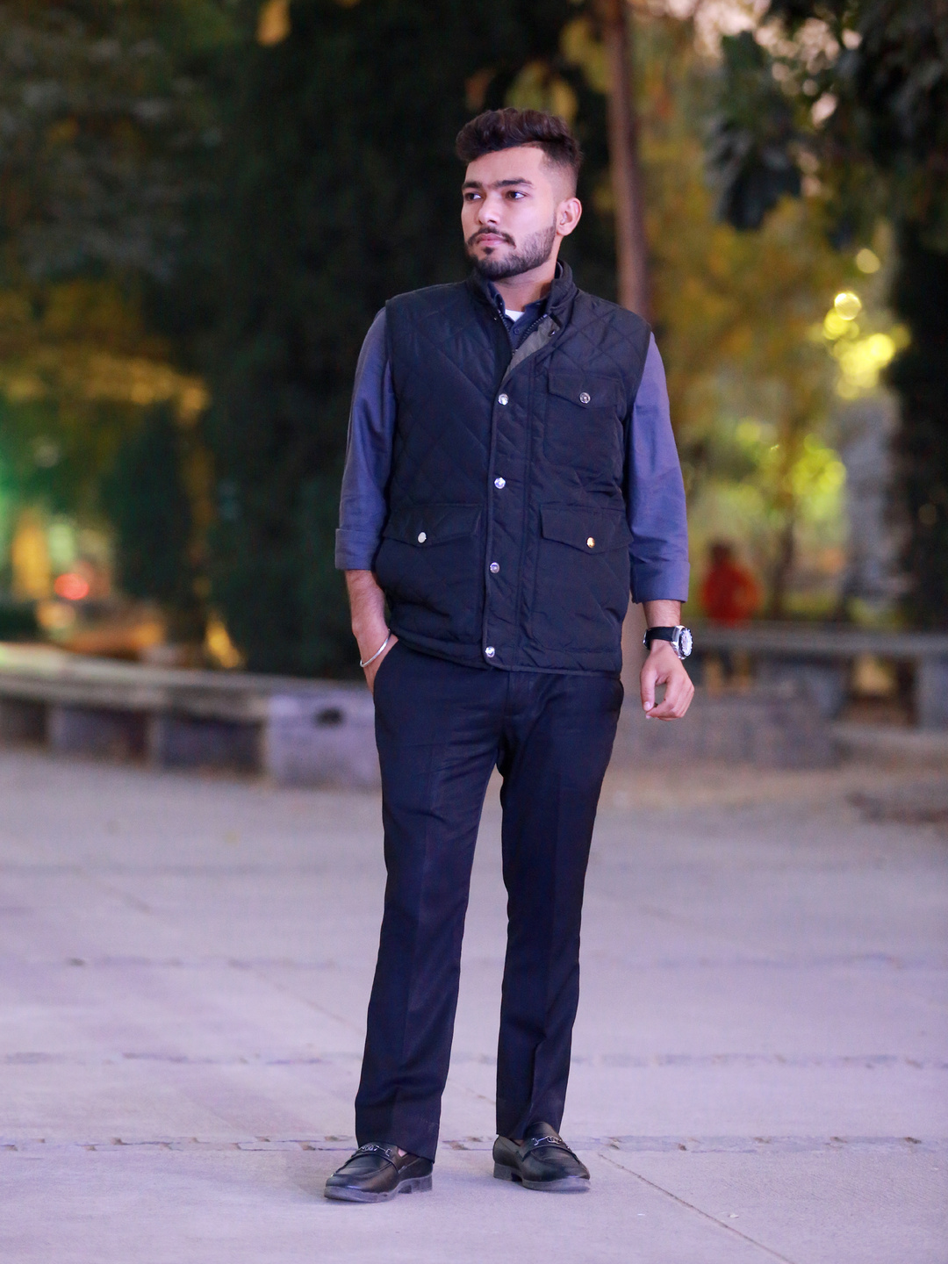
Welcome
Department of Electronics and Communication
Dr. B.R Ambedkar National Institute of Technology, Jalandhar
Presented by: Gulshan (20104034)
Presented to: Dr Asutosh Kar

Slide 3
Company Overview
Objectives of Company
Our Project
Meet Our Team
Tech Stack
Workflow
Difficulties Faced
Achievements
Conclusion
Contents

Slide 4
Company Overview
Pinpencil LLP is a community turned company. It is a team of passionate individuals committed to creating innovative solutions that positively impact society.
Pinpencil manages a diverse range of startups, all working towards making a positive impact on society. Company is committed to providing opportunities for students and professionals to explore the industry and develop their skills.

Slide 5

Objectives of company
Collaboration
Innovation
Social Responsibility
Pinpencil LLP believe in working collaboratively with their clients and partners to achieve the best possible results.
Pinpencil LLP strive to innovate and create products and services that improve people's lives.
Pinpencil LLP is committed to creating a positive impact on society through our work.

Slide 6

Our project
Porfolio Generator
Portfolio Generator is an open source platform that generates portfolio websites for beginners and professionals within few steps. A person can choose a template of his/her choice, enter their details and platform would generate a website for the person.

Slide 7
Gulshan
Our Team
Kuljinder Singh
Lakshya Khandelwal
Kushaldeep Singh Sandhu

Slide 8
Tech Stack
HTML
CSS
JAVASCRIPT
BOOTSTRAP
GIT/GITHUB
VERCEL
NETLIFY

Slide 9
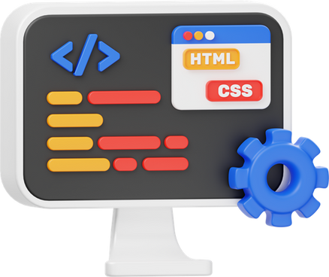
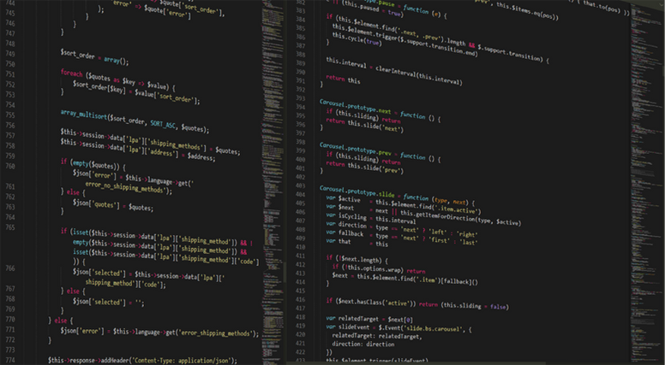

Workflow
01
02
03
Design the template
Creating the basic design, Identifying the elements of the template.
Development
Developing the template with all the functionality using different programming language
Deployment
Deploy the template on GitHub or Vercel or Netlify

Slide 10
Achievements
Got a handful experience on web development: Working on the different templates we got a handful experience in web development and related technologies
Proficient coding skills: Gained proficiency in web development skills like html, CSS,JavaScript, Bootstrap
Industrial Exposure: Got exposure to the industry how the real world industry works and how the live projects are managed

Slide 11
Difficulties Faced
Limited Design Experience: We have limited exposure to diverse design styles and faced challenges in creating templates that cater to various industries and preferences.
Color and Typography Choices: Selecting suitable color schemes and typography that align with design principles and appeal to a broad audience was really challenging task.
Balancing Aesthetics and Functionality: Striking the right balance between a visually appealing design and ensuring the template's functionality was another challenging task.

Slide 12
Conclusion
In conclusion, our internship at Pinpencil LLP was a transformative experience. The challenges, achievements, and collaborative efforts have molded us into a more proficient and adaptable web developer. We are grateful for the opportunities and lessons gained during this journey, which undoubtedly set the stage for our future endeavors in the field of web development.

Slide 13
THANK YOU

